Slide 1
Matthew’s Medical Summary
Opening comments
I wish to thank the FDA for giving the parent group of CBADD the opportunity to speak. It is incumbent upon me to relate to you Matthew’s story, if I have any sense of duty to the next generation. Zellweger’s is a rare disorder; in my life time I have seen the incidence of this disease increase from 1/150,000 live births, to 1/100,000, to 1,/50,000. Children not diagnosed and treated early may suffer irreparable damage decreasing their survival rate and quality of life exponentially. Prevention of degeneration is always for wiser than trying to fix that which becomes broken. As a parent, I cannot allow my son’s story to stay closed in his chart, but as Matthew appeals, open it…to let his life be of value to the children.

Slide 2
Birth Portrait
Low birth weight
Pilonidal crease
Large fontanel
Failed hearing test
Newborn feeding problems
Jaundice
Notes:
Red flags at the combination of symptoms

Slide 3
Hospitalized at 10 weeks
Failure to thrive
Steatorrhea
Episodes of profuse perspiration
Joint crepitus
Extreme fussiness
Elevated VLCFA
Elevated liver enzymes
Notes:
All these tie to liver failure.

Slide 4
Diagnosis: Zellweger’s Syndrome
Liver cholestasis (bile acid deficiency)
DHA deficiency
Impaired plasmalogen biosynthesis
Fat soluble vitamin deficiency (A, D, E, K)
Visual and hearing impairment
Leukodystrophy
Low cholesterol
Notes:
Snap shot of symptoms

Slide 5
Symptoms and Treatment for Zellweger’s
Symptoms
Treatment
DHA deficiency
Bile acid deficiency
Adrenal insufficiency
Low cholesterol
DHA-EE
Cholic Acid
Corticosteroid
?
Notes:
Order of treatment of symptoms, DHA-EE at beginning of 5th month BCN

Slide 6
The Difference of Three Weeks
May 4 May 26
DHA-EE begins at 5 months
Steatorrhea from ++++ to -
Change in liver enzyme tests
Alk Phos from 757 to 339
AST from 459 to 238
ALT from 300 to 141
GGT from 123 to 40
Change in VLCFA’s
26:0/22:0 0.188 to 0.134
26:1/22:0 0.426 to 0.299
Weight gain of 2.9 pounds
Notes:
1st of 18 trips to BCN

Slide 7
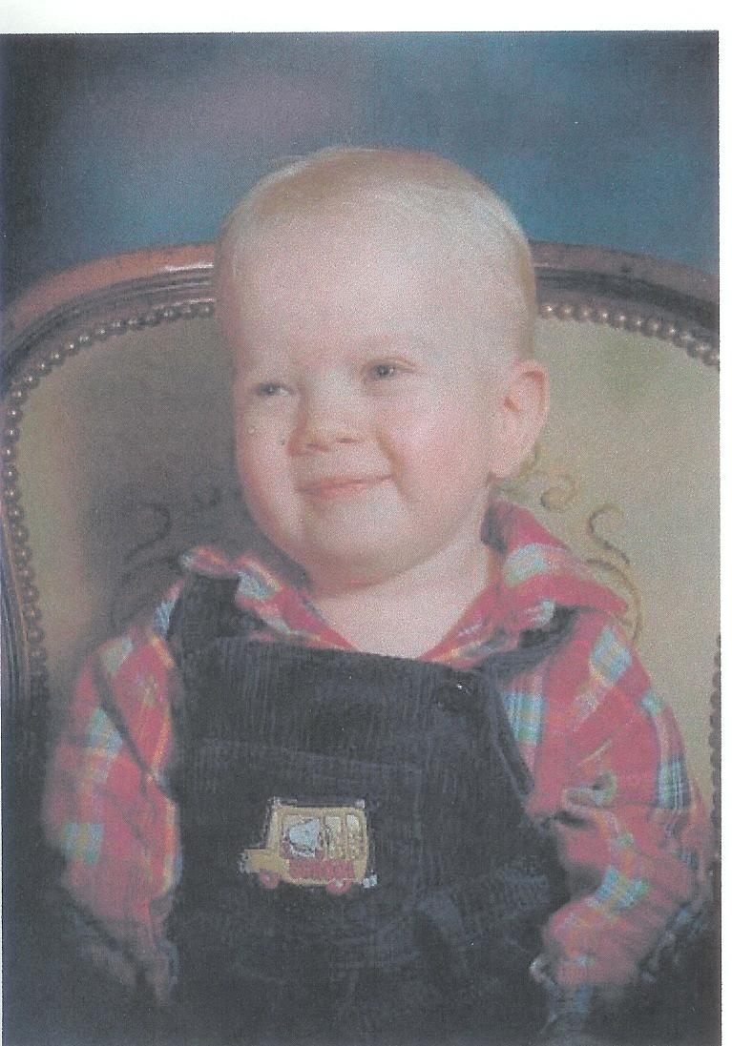
The Difference of One Year
Notes:
Increase in body weight, liver function, muscle tone.

Slide 8
Liver Enzyme Functions at One Year
Notes:
AST from 464 to 173; ALT from 232 to 137; ALKaline PHOSphatase from 751 to 333

Slide 9
Neurological Results
Myelination normal at 2
MRI scans
5 months and 4 years
Notes:
At two Matthew’s brain showed normal myelination for his age.

Slide 10
Bile Acid Deficiency
Two Years
Cholic acid treatment began
Matthew’s condition of newborn cholestasis was a consequence of inadequate bile acid synthesis stemming from a defect in side chain oxidation in the sterol 25-hydrolation pathway common to children with Peroxisomal Biogenesis Disorders, Zellweger’s Syndrome.
Notes:
Stemming from a defect in side chain oxidation in the sterol 25-hydrolation pathway

Slide 11
Results of Cholic Acid
Further improvement in liver enzyme function
Alkaline Phosphatase 166
AST from 130 to 68
ALT from 80 to 40
GGT from 15 to 13
Continued improvements in vision, socialization, muscle tone, and growth
Normal A, D, E, K vitamin levels

Slide 12
One Year of Cholic Acid Treatment Liver Biopsy Report
Notes:
Liver architecture looks quite good; very little active inflammation and only mild scarring.

Slide 13
Liver Biopsy Report after Two Years on Cholic Acid
Notes:
No Hepatocyte steatosis or cholestasis identified at 4 years…only a slight increase of periportal and pericellular fibrosis

Slide 14
DHA-EE and Cholic Acid Treatment in Zellweger’s Syndrome
Reduced liver enzyme function tests
Improved nutrition
Absorption of fat-soluble vitamins
Weight gain and growth
Irritability amended
Gains in socialization, muscle tone, and vision
Lower VLCFA’s
Recovered plasmalogen ratios
Myelination normal
Higher DHA levels
Notes:
Changes gained by treatment

Slide 15
Correction of symptoms
DHA deficiency: decreased growth and survival of neurons along with inhibition of cell membrane properties and activity of membrane bound enzymes, availability of neurotransmitters, diminished myelination, vision and hearing impairment, cognitive decline, elevated behavior indices, low plasmalogen ratio (cataracts), and seizure disorder.
Bile acid deficiency: fat-soluble vitamin deficiency (Vit. ADEK deficiencies: poor vision, development of retinitis pigmentosa, effect bone and tooth development, gene expression, cell growth, impaired balance and coordination (ataxia), myopathy, peripheral neuropathy, and newborn brain bleeds.), jaundice, stunted growth, diarrhea, loss of liver function, neural and adrenal toxicity, endocrine dysfunction, liver damage.
Cholesterol deficiency: developmental delay, failure to thrive, hypotonia, large fontanel, deficiency in Co Q-10, adrenal gland hormone, bile acids, and vitamin D.
Notes:
All of these deficiency views described my son; all tie into the liver working correctly through cholic acid and DHA-EE. *NOT READ*

Slide 16
Difference of No Treatment
Bile acid deficiency in Zellweger’s kills, slowly as starvation and malnutrition kills.
Bile acid deficiency in Zellweger’s is toxic
To the liver
To the nervous system
To life.
Bile acid deficiency in Zellweger’s is unnecessary and curable.
Notes:
If no treatment = slow painful death, a death that could have been prevented

Slide 17
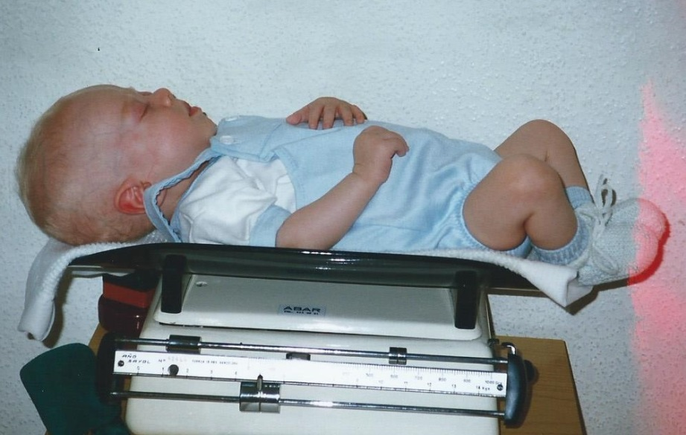
Increased Life Expectancy and Quality of Life
Matthew given 6 months to live due to Zellweger’s, Neonatal Adrenal Leukodystrophy (NALD)
Today Matthew is an honor student, poet, author, and composer.
Notes:
Matthew was given 6 months, today …

Slide 18
Closing comments
Matthew grew up under a death sentence, with no treatment, only palliative care. We ask the FDA to look into Matthew’s open chart and consider the results of treatment, to consider what could have been, …and what is, then to make a difference for tomorrow’s children. Matthew’s dream is to have his life be of benefit to the children.

